Slide 1
Marketing Mix
Modelling Analysis

Slide 2
1. Introduction
2. Objective
3. Dataset Overview
4. Approach
5. Exploratory Analysis
6. Model Building and Results
7. Conclusion & Recommendations

Slide 3
Objective / Problem Statement
Business Question :
1. How can we quantify the impact of different marketing channels (e.g., TV, digital, print, promotions) on sales?
2. Which channels drive the most ROI, and where should future marketing budgets be allocated?
Why It Matters :
Marketing spends are significant, but without measurement, it’s unclear which channels truly generate value.
A Market Mix Model (MMM) helps optimize spend allocation by separating the contribution of each channel from external factors (seasonality, pricing, competition).
Results guide data-driven budgeting decisions, leading to higher efficiency and revenue growth.

Slide 4
Dataset Overview
Source :
Case study dataset (Case_Study_Input_File.xlsx).
Contains 48 rows (time periods, likely weeks/months) and 41 columns (sales, marketing, distribution, etc.)
Key Features :
Sales KPIs : kpi_val_sales_mn, vol_sales_mn
Marketing Inputs : trade_promo_spends_mn, consumer_promo_spends_mn, newspaper_spends_mn, tv_total_grp, digital spends, impressions, etc.
Distribution Metrics :wtd_dist_max, num_dist_max
Other Controls : newspaper impressions, possibly seasonality or external factors
Data Quality Checks :
1. No missing values found
2. No duplicate rows detected
3. Preprocessing: removed duplicates, checked for nulls, ensured data consistency
Data Size :
48 periods × 41 variables

Slide 5
Approach / Methodology:
1. Data Loading & Setup :
Imported key libraries: Pandas, Matplotlib, Seaborn, Statsmodels, Scikit-learn. Loaded dataset (Case_Study_Input_File.xlsx) into a Pandas DataFrame. Converted date column into proper datetime format.
2. Data Understanding & Cleaning :
Explored dataset using .head(), .info(), .describe()., Checked for duplicates, Confirmed data types and ensured consistency.
3. Exploratory Data Analysis (EDA) :
Visualized media spends across multiple channels: TV, Newspaper, Google Display, YouTube, Facebook/Instagram, WhatsApp, Jio, Hotstar. Identified trends and seasonality using line plots.
4. Feature Engineering :
Selected media spend columns as key drivers of sales., Designed adstock transformations to capture lagged and saturation effects of advertising., Normalized/standardized variables (StandardScaler) for regression.
5. Modelling :
Built Market Mix Models using – i. Linear Regression and ii. Lasso Regression (LassoCV) for regularization.
Applied train-test split for model validation., Evaluated performance using R², RMSE, MAE.
6. Interpretation & Insights :
Interpreted regression coefficients to estimate channel contributions. Measured ROI per media channel (sales per unit spend).

Slide 6
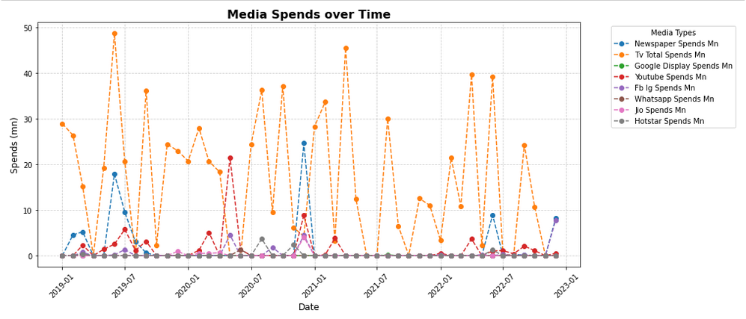
Exploratory Data Analysis :
1. Media Spent over the Time Analysis :
The graph shows fluctuations in media spends, with some months showing sharp peaks while others have very little or no spending.
The orange dashed line represents TV Total Spends, which is by far the highest and most frequent among all media types. There are several spikes where TV spends reached around or above 40-50 mn, indicating significant advertising campaigns.
Newspaper, YouTube, Facebook, and WhatsApp spends are visible but relatively low. Most of these lines hover near zero, with occasional peaks suggesting smaller campaigns or targeted promotions.
Peaks across all channels around specific months (especially early 2019, mid-2020, and late 2022) suggest campaigns linked to events, festivals, or product launches. The irregular spikes reflect that media spends were not uniform and were perhaps driven by business needs or external factors.

Slide 7
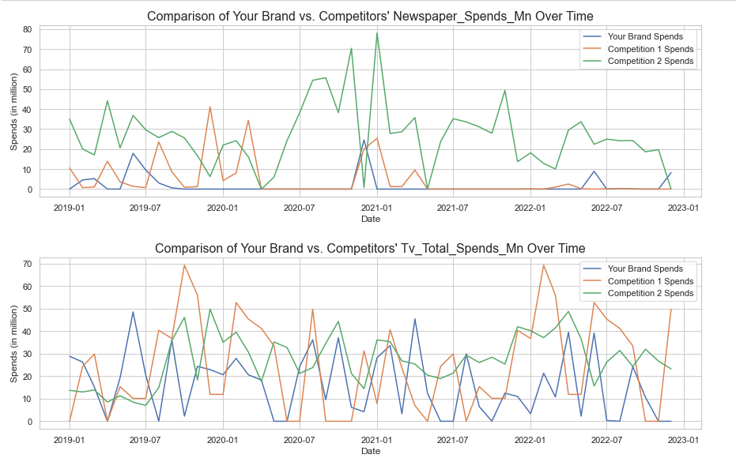
Channels like Hotstar, Jo, and WhatsApp have barely noticeable spending throughout the period, indicating they were either used minimally or not at all in some months.
Channels like Hotstar, Jio, and WhatsApp have barely noticeable spending throughout the period, indicating they were either used minimally or not at all in some months. Other channels like YouTube and Facebook were used occasionally, perhaps for targeted digital campaigns rather than continuous investment.
2. Competitive Media Spending Analysis :
Based on the charts, In newspaper advertising, the brand's spending has been minimal and has dropped to almost nothing since mid-2020, while Competitor 1 has maintained a moderate, sporadic presence, and Competitor 2 has consistently been the most aggressive spender, with major peaks often exceeding 40 million dollers. In contrast, the TV advertising landscape is highly competitive, with all three brands making significant investments. The brand's TV spending has fluctuated with high peaks in late 2019, early 2020, early 2021, and mid-2022. Competitor 1 also engages in a strategy of large, intermittent TV campaigns, with a massive spike reaching nearly $70 million in late 2019.

Slide 8
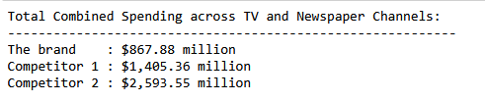
Meanwhile, Competitor 2 stands out with the most consistent and stable TV spending, maintaining a high level of investment throughout the years.
The brand should strategically re-evaluate its media spending to align with market trends and competitor behavior. Don't simply follow the competitors, but rather learn from them to build a more robust, multi-channel marketing strategy
3. Total Spends on Different Marketing Channels - Brand and Competitors :
Market Dominance: Competitor 2 is likely pursuing an aggressive, market-dominant strategy by investing heavily in both TV and newspaper advertising to capture the highest share of voice and maintain brand awareness.
Active Competition : Competitor 1 is also a strong player, investing substantially more than the brand to actively compete for market share in these traditional channels.
Strategic Allocation : The brand's relatively lower spending suggests a different strategic focus. This could be a decision to allocate a greater portion of the marketing budget to other platforms, or a more conservative approach to traditional media.

Slide 9
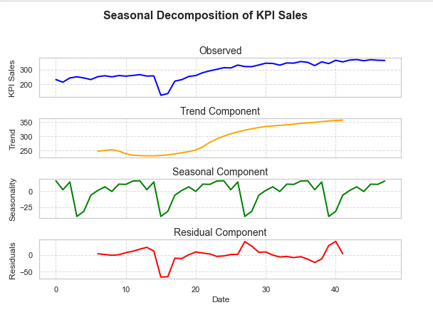
4. Time Series Decomposition on Sales Data :
The above diagram shows four subplots representing the decomposition of the KPI Sales time series into its components: Observed, Trend, Seasonal, and Residual.
Observed Component : This is the actual data of KPI sales over time. The plot shows an increasing trend over time, but there’s a noticeable dip around early 2020. The dip likely corresponds to disruptions (such as the COVID-19 pandemic affecting sales). After that period, sales gradually recover and trend upward.
Trend Component : The trend shows the overall direction of KPI sales, smoothing out short-term fluctuations. It confirms that sales were relatively stable before early 2020, then declined briefly, and recovered into a consistent upward trend. This indicates long-term growth despite temporary disruptions.

Slide 10
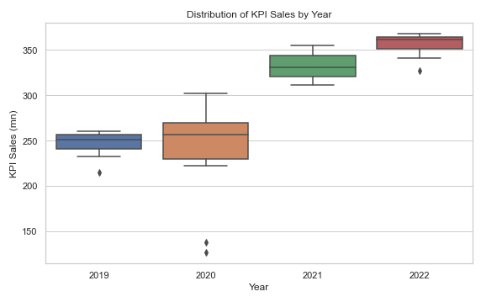
Seasonal Component : The seasonal plot highlights patterns that repeat regularly over time. There’s a cyclical pattern visible across years, suggesting that sales have predictable ups and downs at certain times of the year. The dips and peaks likely correspond to recurring events like holidays, promotions, or other seasonally driven behavior.
Residual Component : The residuals are what’s left after removing the trend and seasonal effects — essentially, random noise or unexplained variations. The residuals hover around zero most of the time but show occasional sharp deviations. Large residuals, especially around early 2020, suggest anomalies or external shocks not captured by trend or seasonality (again, possibly pandemic-related disruptions).
5. Spread of The Data :
Overall, the box plot clearly demonstrates a positive upward trend in KPI sales from 2019 to 2022. Each year's median sales are higher than the previous year, showing consistent growth. The spread of the data (the size of the box) varies each year, indicating fluctuations in sales consistency. For example, sales were most consistent in 2019 and 2022 and most varied in 2020.

Slide 11
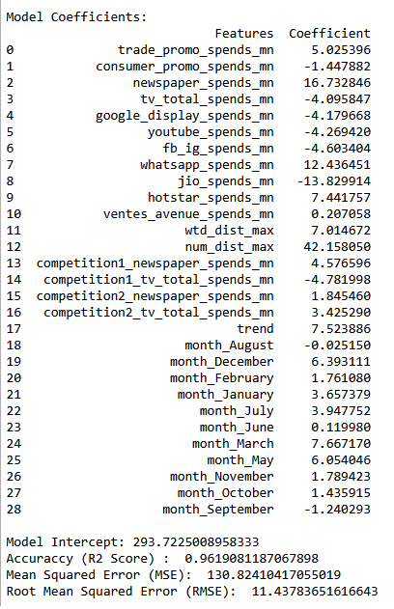
Model Building and Results
Our model is performing very well. It is able to explain over 96% of the changes in our sales, which means it understands the factors driving sales almost perfectly. This gives us confidence that the model is capturing the right patterns and relationships.
Additionally, the model estimates that, even without any marketing efforts, the company would still generate around 293 million Doller's in sales. This is called the baseline sales — the number of sales we can expect without extra promotional activities.
When we compare the model’s predictions to the actual sales, the difference is, on average, only about 11 million Dollar’s. Considering the scale of the business, this is a small error, and it shows that the model is highly accurate and reliable.
Above we can see model coefficients as well, some features have very small or even negative coefficients, meaning they contribute little or could introduce noise. Handling such features properly is essential to prevent overfitting and ensure the model generalizes well to unseen data.
Here Regularization is coming into the picture..
Regularization helps by adding a penalty term to the loss function, which discourages the model from assigning too much importance to certain features, making the model more generalizable and robust.

Slide 12
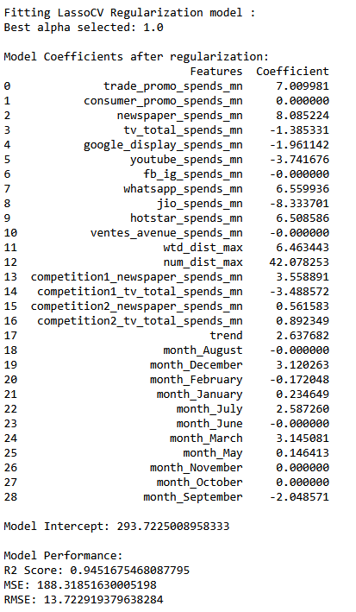
Here we are moving forward with Lasso Regression (L1 Regularization) Because :
Our sales analysis provides highly reliable insights, with a model that explains 94% of the changes in our sales. To achieve this, we used a statistical technique called Lasso regression, which automatically identified and focused on only the most important features, effectively filtering out less relevant ones. This process yielded a precise model that confirmed our baseline sales figure of over 293 million dollar's the revenue we can expect without any marketing efforts. The model's predictions are, on average, only 13 million away from our actual sales, further confirming its accuracy. Ultimately, the analysis highlighted a strong long-term market trend and effective campaigns in newspaper and Google Display as our primary growth drivers, while also pinpointing channels like YouTube and Jio as areas requiring strategic re-evaluation.

Slide 13
Conclusion & Recommendations
1. Contribution Analysis :
Our analysis indicates a baseline sales figure of approximately 294 million, representing a strong foundation. Our marketing efforts contribute to this, with Trade Promotions being the most effective channel, driving over 60 million in sales and accounting for nearly 19% of the total marketing contribution. Newspaper and Hotstar also show positive contributions. However, several channels, most notably TV, YouTube, and Jio, showed negative contributions in this model. I interpret these not as a negative impact on sales, but rather as an indication of zero or unmeasurable effectiveness in the current strategy, suggesting these channels are underperforming and require re-evaluation.
2. Return on Investments (ROI):
Our ROI analysis reveals that WhatsApp is our most efficient channel, generating 0.21 dollers in sales for every dollar spent. Newspaper and Hotstar also show positive returns, with ROIs of 0.17 dollersand 0.18 dollers respectively. While none of these are yet profitable (where ROI > 1.0), they are the most effective at driving revenue from our investment. Conversely, channels with negative ROIs, such as TV, YouTube, and Jio, are currently ineffective at driving sales, and their budget should be re-evaluated and potentially reallocated to the higher-performing channels.
3. Budget Allocation Recommendation :
Based on the analysis, my recommendations for budget allocation are clear and data-driven. The channel with the highest ROI is WhatsApp, and I would therefore recommend increasing investment in this area by reallocating funds from lower-performing channels to maximize our return. Conversely, the channel with the lowest or negative ROI is Jio, indicating it is not an effective driver of sales. I would recommend either a significant decrease in its budget or a complete re-evaluation of our strategy for this platform. This strategic shift will ensure our marketing spend is optimized and generates the highest possible sales contribution.

Slide 14
thank you
Tushar Sutar
  8668978920
  tusharsutar27@gmail.com

